Slide 1

ETHICAL SERVICE
AWARENESS . ENGAGEMENT . ACCOUNTABILITY
ORIENTATION FOR EXECUTIVE BRANCH EMPLOYEES

Slide 2

“Ethical conduct” involves just that—conduct. It is a measure of how well you make decisions and perform your duties in accordance with public service
principles and standards.

Slide 3

We are committed to upholding the highest principles and standards of ethical conduct in all that we do. We apply these principles and standards in the course of our daily work, and by faithfully observing them, we safeguard the honor of public service and the reputation of the executive branch. Through them, we hold ourselves and each other accountable for the integrity of our service to our country and to our fellow citizens
OUR PRINCIPLES
&
STANDARDS OF
ETHICAL CONDUCT

Slide 4
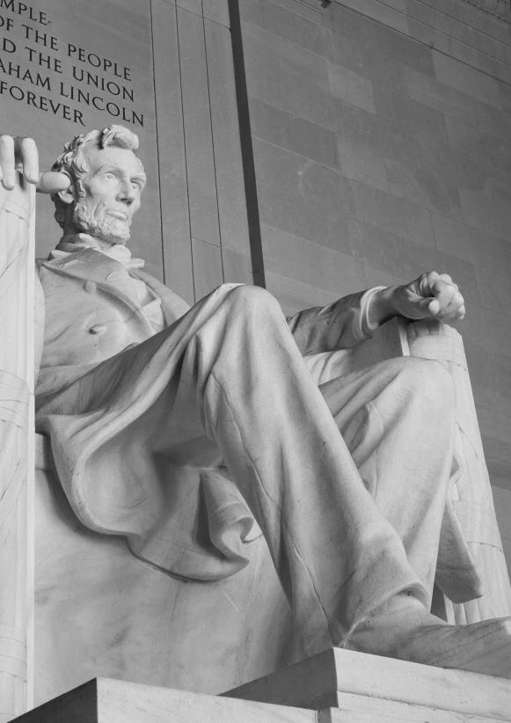
YOUR COMMITMENT
F
ulfulling the expectation of ethical service requires:
Awareness: becoming familiar with ethical principles, rules and laws
Engagement: cultivating habits of asking questions and seeking advice
Accountability: acting in ways that reflect the expectations of public service, and holding ourselves and each other accountable

Slide 5
AWARENESS
1
CHAPTER
We are guided in our conduct by a set of principles, and a specific and enforceable set of standards and laws.

Slide 6



GENERAL PRINCIPLES
RESPECT THE RULE OF L AW
DO NOT MISUSE YOUR PUBLIC POSITION FOR PRIVATE GAIN
BE RESPONSIBLE IN THE USE OF YOUR TIME AND RESOURCES
LOYALTY TO LAW
SELFLESS SERVICE
RESPONSIBLE STEWARDSHIP

Slide 7

STANDARDS OF ETHICAL CONDUCT
Use of Government Position
Conflicting Financial Interests
Impartiality
Seeking Other Employment
Outside Activities
Gifts from Outside Sources
Gifts Between Employees

Slide 8

ETHICAL SERVICE
Placeholder for Scenarios
WHAT DO YOU THINK?
WHAT WILL YOU DO?

Slide 9
14 GENERAL PRINCIPLES
OF ETHICAL CONDUCT
ETHICS OFFICE
INFORMATION
STANDARDS OF ETHICAL
CONDUCT
CRIMINAL CONFLICT OF
INTEREST LAWS

